Slide 1
Deep Learning : Image recognition Capstone project #3
April 02, 2022
Manika Midha

Slide 2
Goal : Build a Neural Network that recognizes objects in images
Create a custom convolutional neural network model
Used pre trained model VGG16
Used transfer learning
Softwares : Python3, Jupyter Notebook
Libraries : Matplotlib, Numpy, Tensorflow
Dataset – Cifar-10, link : https://www.cs.toronto.edu/~kriz/cifar.html
This dataset consists of thousands of images of 10 different objects. Each image is labelled, so we know which kind of image it is. Using this dataset, we can train our NN to identify these objects

Slide 3
Structure
Neural Network
Image Classification
Architecture of Deep Neural Network
Data exploration
Create a Neural Network from scratch
Use pre-trained model – VGG16
Use Transfer Learning
Comparison of neural networks created

Slide 4
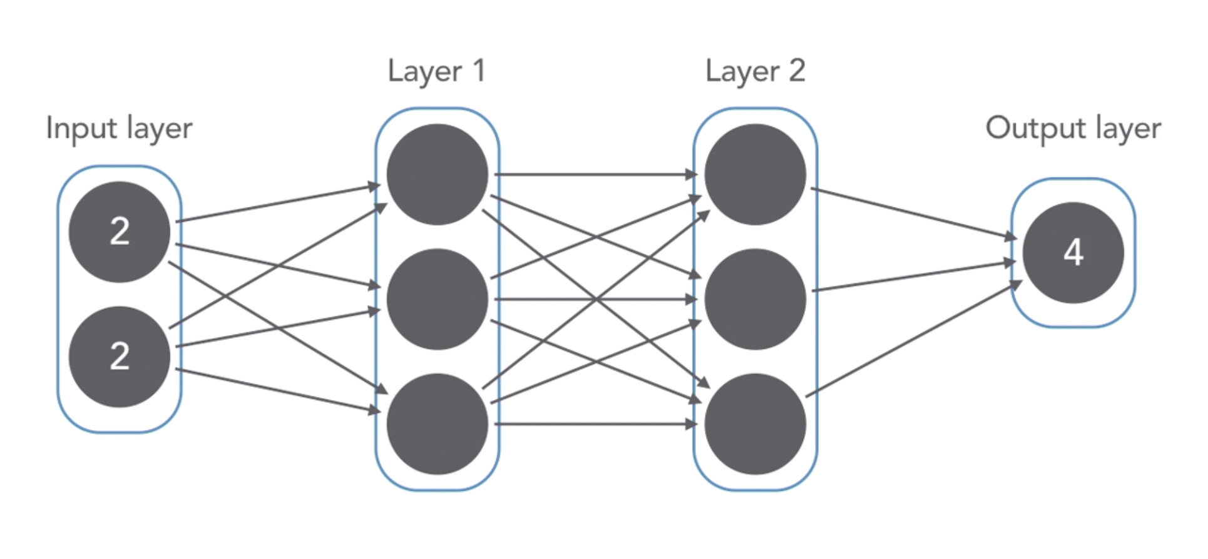
Simple Neural Network that takes two inputs and produces their sum as output
Neurons
Densely connected layers
Notes:
Neurons are arranged in series of groups called layers. Nodes in each layer are connected to nodes in following layer. These are called densely connected layers.
Data flows from input to output along these connections.
Each node is trained to perform a simple mathematical calculation and feed the results to all nodes it is connected to. The NN takes a set of values in the input layer and then these values
Pass through all following layers. Each node tweaks the value it receives slightly and passes its result to the next node. Eg:, we can use this NN to do addition.
Before values flow from one layer to another, they pass through an activation function. Activation functions decide which units from the previous layer are important enough to feed to the next layer

Slide 5
How Image Classification works ?
Definition : Ability for computers to look at a photograph and understand what is is inside

Slide 6
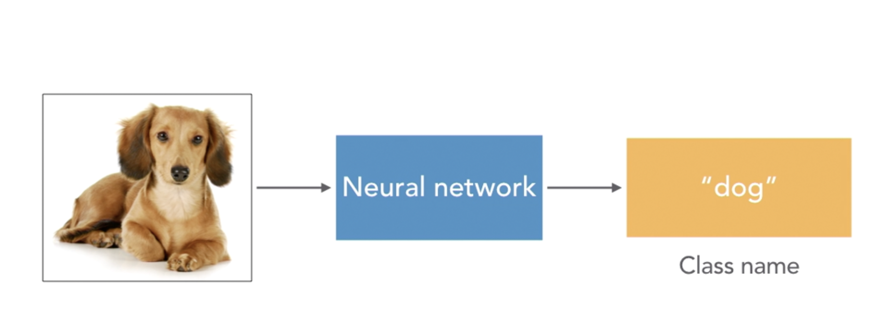
Feed an image to a Neural Network which produces a dog label, as that is the main object that appears in the image

Slide 7
Deep Neural Network
Definition : Adding more layers to a Neural Network gives it more capacity to identify
more complex patterns and shapes

Slide 8
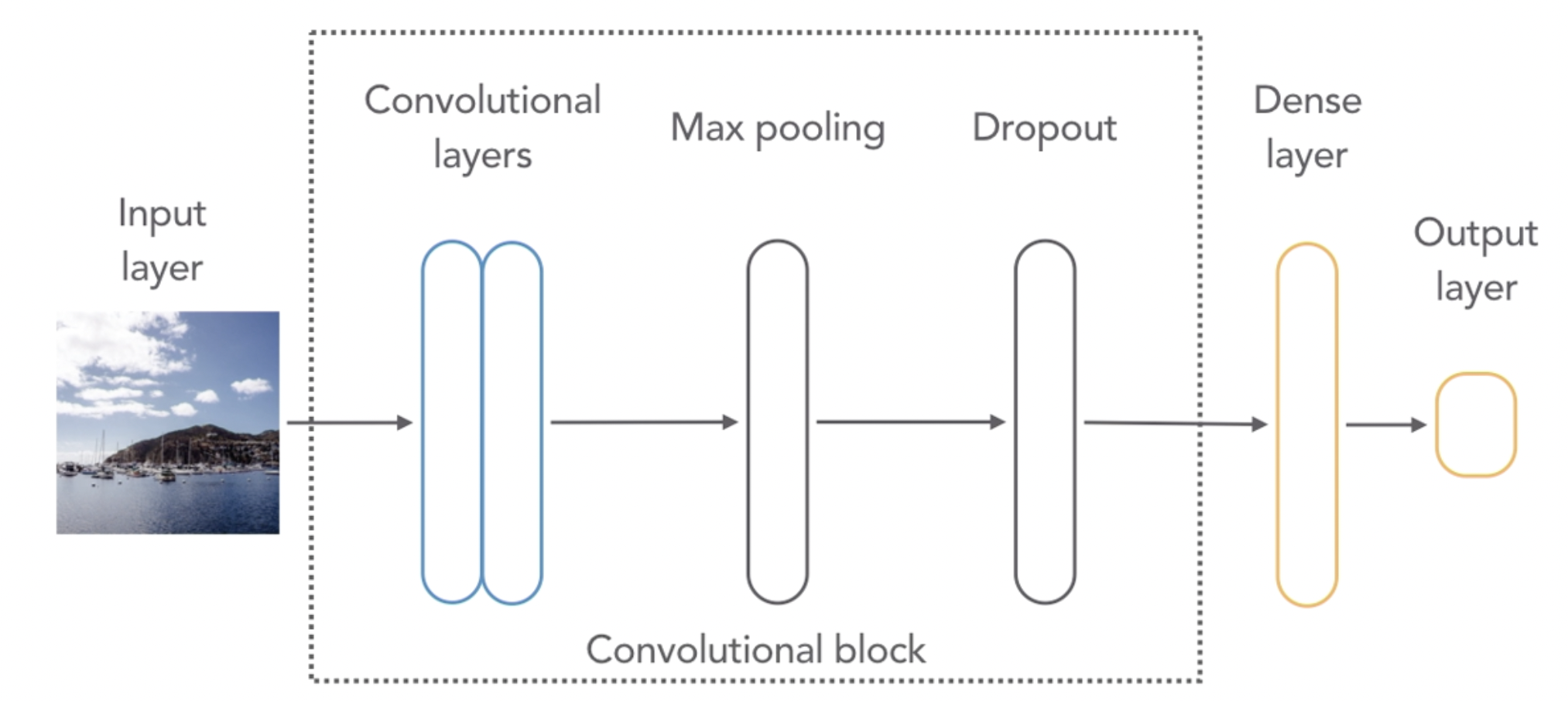
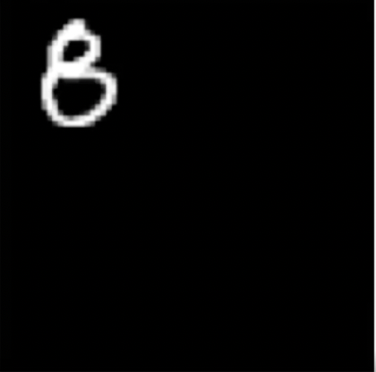
Convolutional layer is added to make it possible to detect a pattern in an image no matter where it is located in the image – Translational invariance
The idea of Max Pooling is to down sample the data by passing on the most important bits only. The output will be the same though it will be less work for the Neural Network
Dropout layer throws away some data randomly, forcing the Neural Network to try hard to learn and not memorize training data
Dense layer maps the output of the previous layers to the output layer so that Neural Network can predict which class the input image belongs to

Slide 9
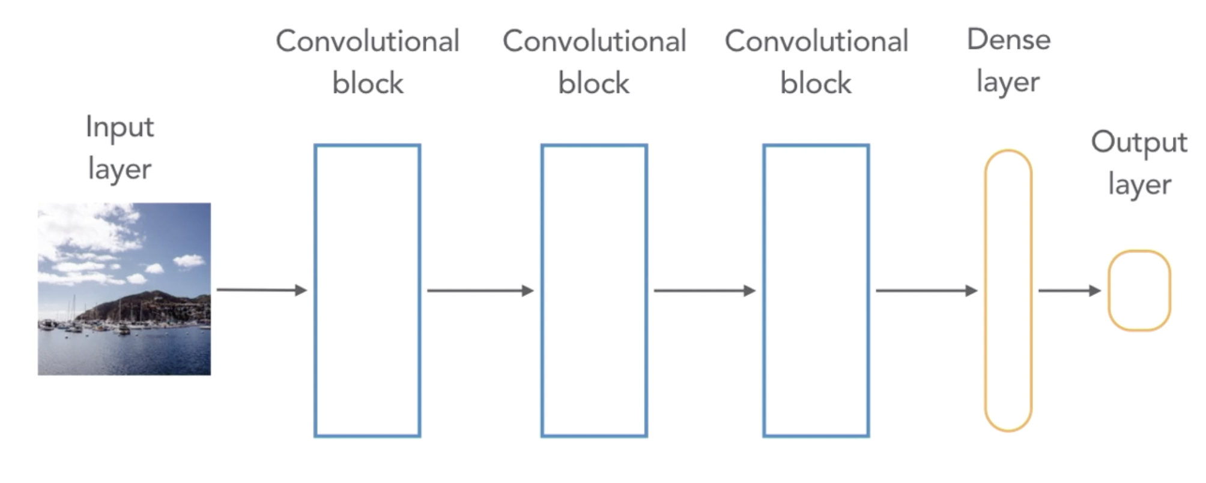
To make our Neural Network more powerful and be able to recognize more complex images, we can add copies of convolutional block

Slide 10
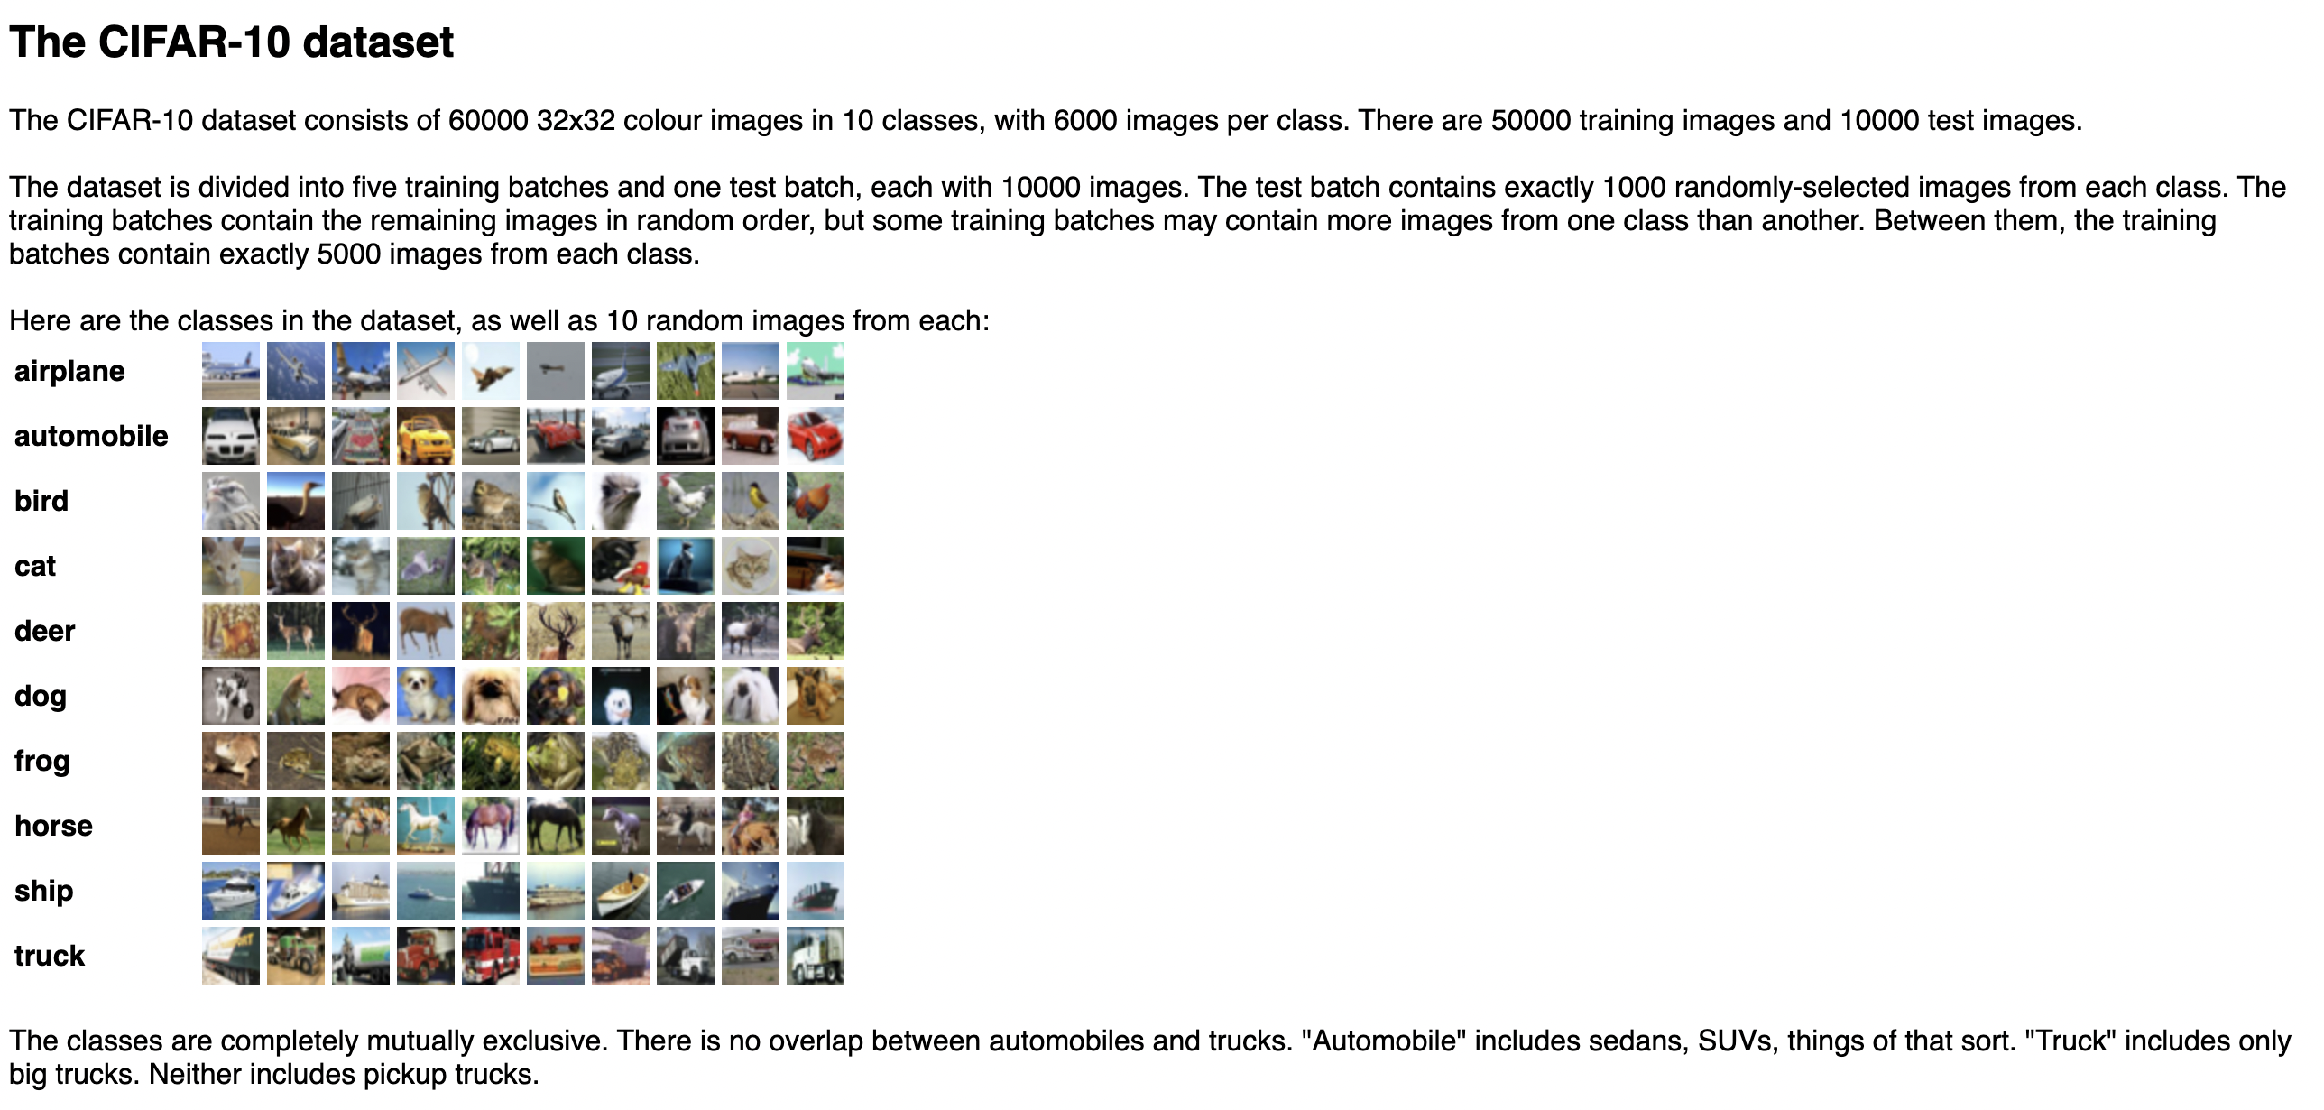
Data Exploration
Images – 32x32 pixels (smaller size will help the Neural Network train faster)
10 different types of classes
Total images - 60,000 . Training data : 50,000, Test data : 10,000

Slide 11
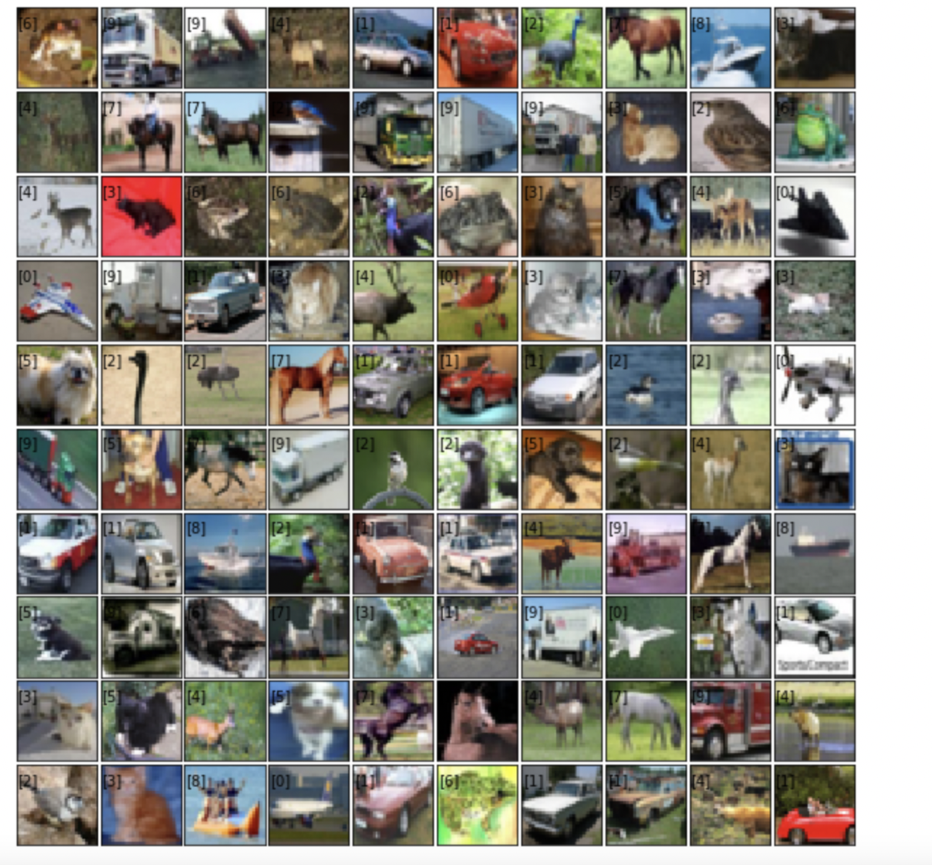
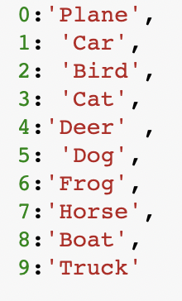

Slide 12
Create a Neural Network from scratch

Slide 13
Steps :
Data Preprocessing :
Load dataset and split data into train and test
Convert data into float and normalize
Convert each label (0 to 9) to an array of 10 digits with only one element set to 1 and rest set to 0’s
Create a sequential model and add layers
Conv2D, Conv2D,MaxPool2D,Dropout – 4 layers
Conv2D, Conv2D,MaxPool2D,Dropout – 4 layers
Flatten
Dense layer
Dropout
Dense output layer
Compile model :
loss = categorical cross entropy
metric = accuracy
Train model :
Epochs = 30, Batch size = 64
Training time = 1298.42 secs/ 21 minutes
Loss = .3013 , Accuracy =.8950
Save model structure and weights in files
Predict :
Load trained model’s structure and weights
Use test image – convert to numpy array and normalize, add fourth dimension
Predict

Slide 14
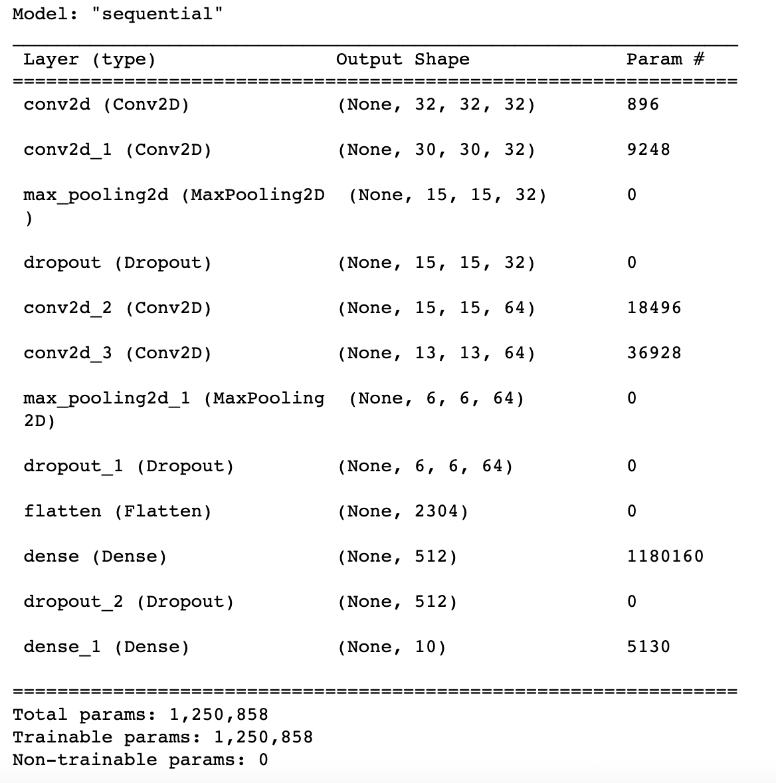
Number of parameters in max pool layer is 0. Instead of increasing the size of the Neural Network, they help us decrease the size by scaling down the data that passes through them, keeping the most
important values.
This will help speed up the training process
As we are just throwing data, dropout does not add any parameters to Neural Network

Slide 15
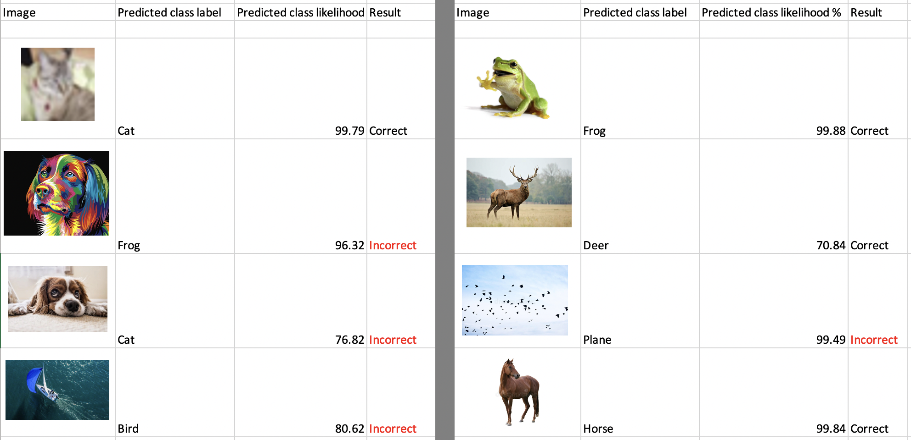
Custom Neural Network – trained on 50000 images, tested on 10000 images. Has 10 classes
Notes:
8 layers deep - model

Slide 16
Use Pre-trained models : VGG16
Dataset of millions of labeled pictures. It is a deep neural network that is 16-19 layers deep. Created by University of Oxford in 2014.
Trained on Imagenet database - https://www.image-net.org/about.php.

Slide 17
Steps :
Create a VGG16 model
Load test image
Convert to numpy array, add fourth dimension
Normalize data
Make prediction
Decode prediction

Slide 18
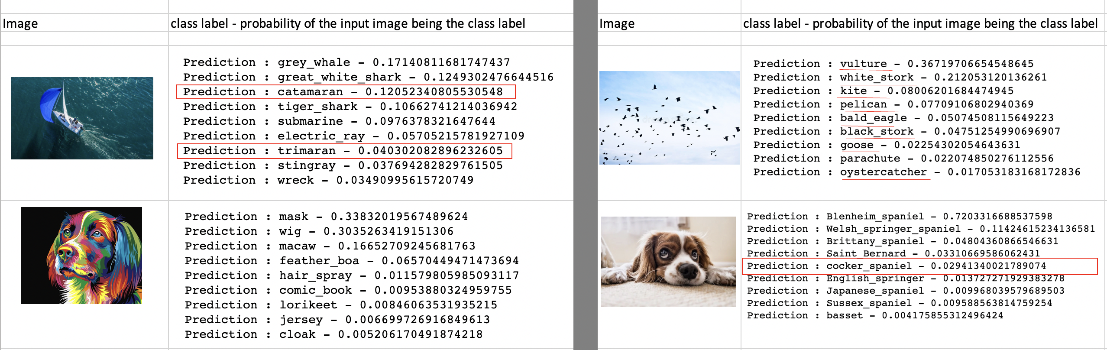
VGG has 16 layers. Trained on approximate 14 million images and has 1000 classes

Slide 19
Transfer Learning
Use a model trained on one set of data as a starting point for modeling a new set of data

Slide 20
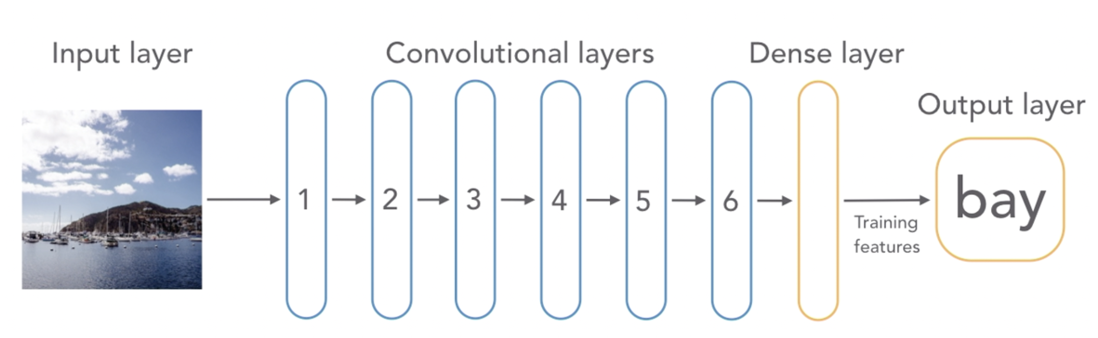
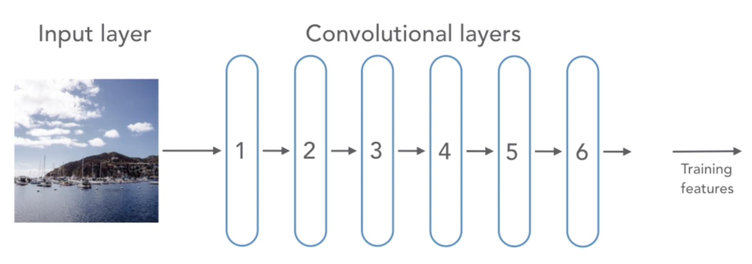
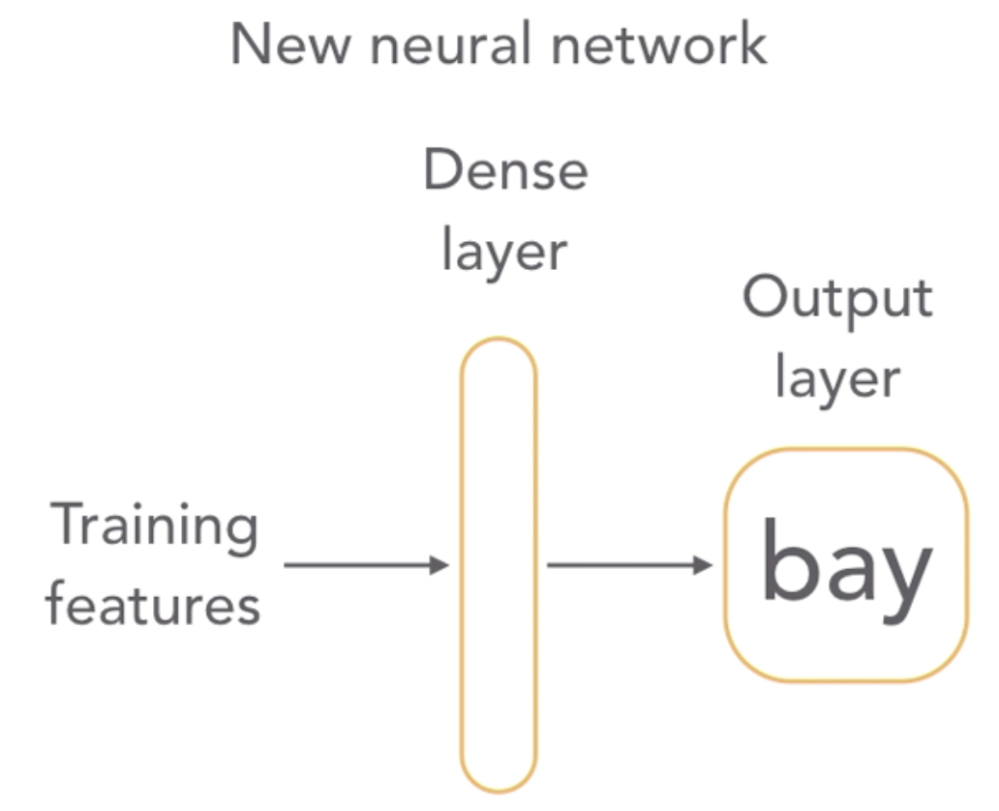
Standard Convolutional Neural Network
Transfer learning
Feature Extractor - Remove the last layer
Create a new Neural Network to replace the last layer we sliced off
Notes:
. In transfer learning, we start with a CNN that has been trained on a large dataset.
In TL, we keep the convolution layers that identify patterns in the image but remove the last layer that maps those patterns to objects.
We will have to train the new neural network only.

Slide 21
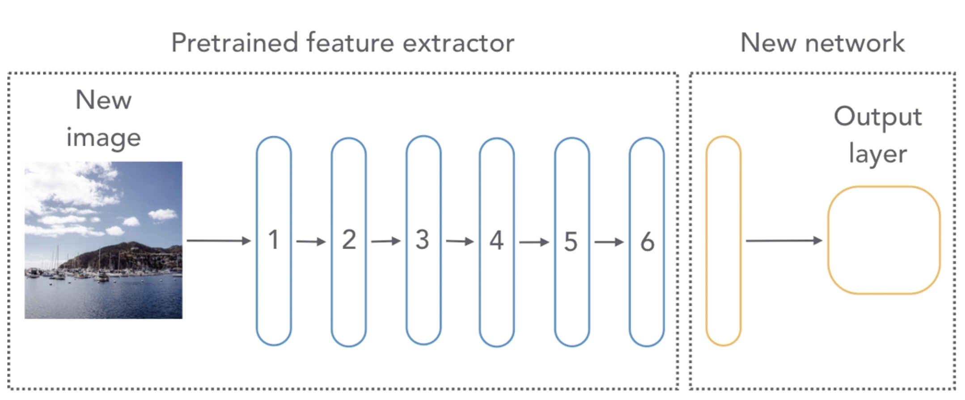
Predict with transfer learning
Notes:
The feature extractor will extract features from the new image. We will save these in a file. Then, we will use pass these features to our newly trained network to make a prediction.
Almost always, use transfer learning first. If it works, there is no need to train a model from scratch. It is useful when you don’t have lot of training data but have a model that solves a similar problem.

Slide 22
Steps :
Extract features with pre trained neural network:
Create images list - 32 dog images and 32 not-dogs images from imagenet database
Create labels list – 0 for dog and 1 for non-dog
Converted lists to numpy arrays
Normalize images array
Use a pre-trained NN (VGG16) to be used as a feature extractor, removed the last/top layer
Make prediction on normalized images array using above model.
Save predictions and labels array
Train new NN with extracted features in the last step:
Load extracted features (images + labels)
Create a sequential model using only Flatten and Dense layers
Compile and fit the model
Save the model structure and weights
Make Prediction using new images
Use saved model structure and weights
Load test image, converted to numpy array, normalize it
Extract features of test image using VGG16 and make prediction
Make final prediction using saved model

Slide 23
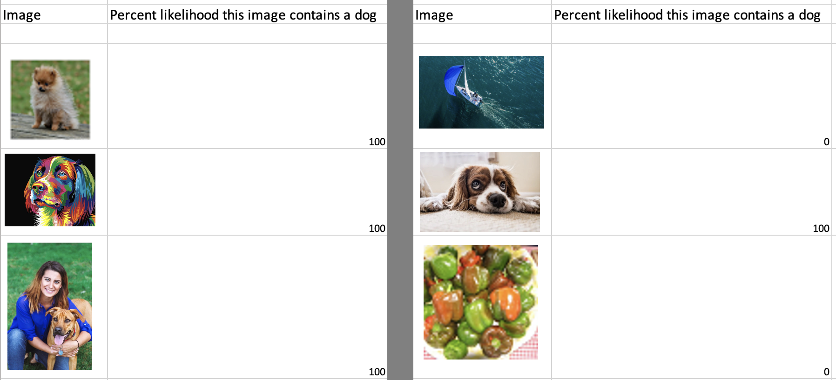
Trained on 64 images from imagenet database – 32 dogs + 32 not dogs
Notes:
Our training data was very small – 32 dog images + 32 non-dog images. This is quite powerful as with a few training images (64) we have built an accurate model that distinguishes between dogs and non-dogs. The training time was less, few seconds.

Slide 24
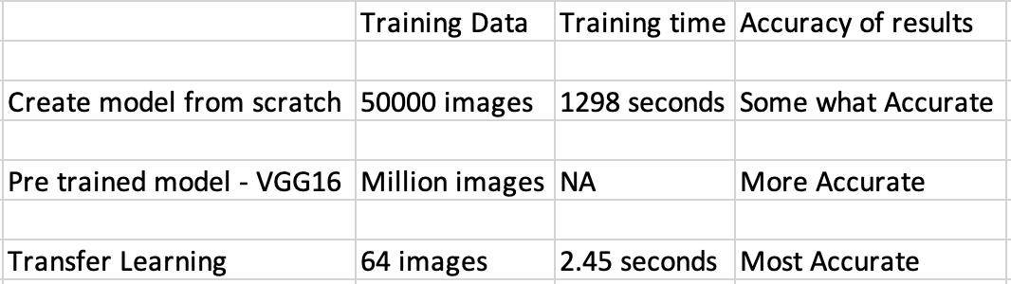
Conclusion

Slide 25
Thank You

